Slide 1
Freesurfer Cortical Quality Check Lianne Schmaal – ENIGMA MDD
Remarks from sites:
Difficult to judge whether the quality of the cortical parcellations are ok
Exclusion of bad regions becomes arbitrary
Regions parcellated by FS quite aspecific: previously found cortical structural abnormalities are more specific so we might miss a lot of potential patients-controls differences
Many outliers in outlier.log file
Some sites perform manual editing, some don’t

Slide 2
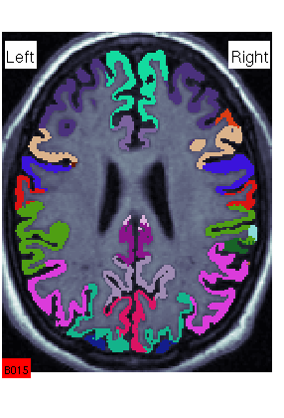
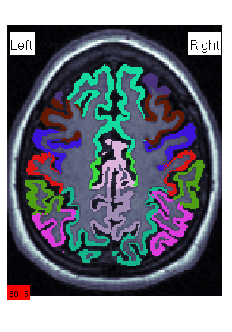
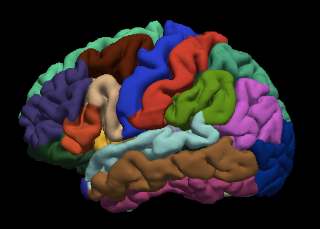
Good examples

Slide 3
Bad example

Slide 4
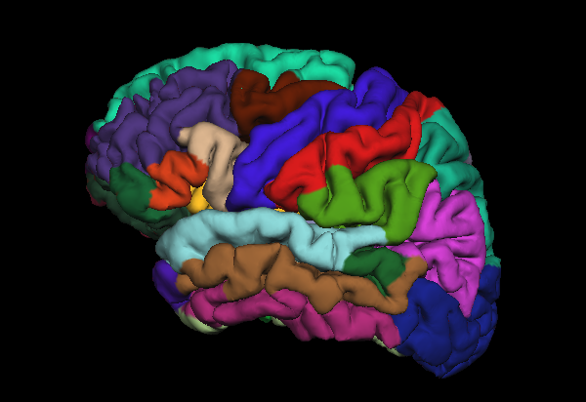
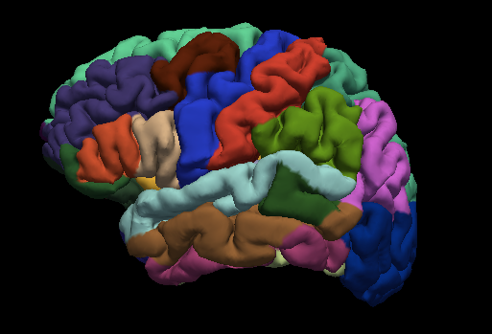
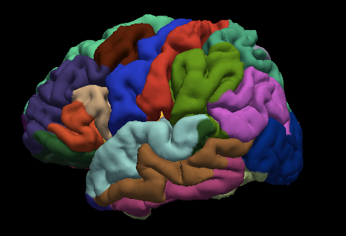
Bad examples; banks of superior temporal sulcus (BanksSTS; darkgreen)

Slide 5
Bad examples; banks of superior temporal sulcus
In some samples, the dark green patch appears to be shown in outer surface in about 20-30% of cases. In some of these the patch is of a size where it could influence the measures and clearly (see pervious examples).
Solution:
EXCLUDE the bad BanksSTS parcellated regions + also adjacent regions in case those are affected (e.g. superior temporal gyrus and/or middle frontal gyrus as in previous examples
Examples of OK parcellated BanksSTS: see next page

Slide 6
Ok examples (i.e. do not exclude); banks of superior temporal sulcus (BanksSTS; darkgreen)

Slide 7
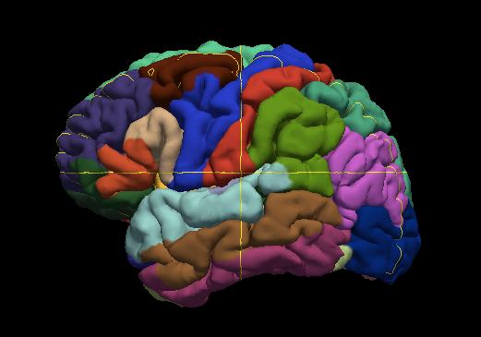
Bad examples; Supramarginal gyrus extends (light green) into superior temporal gyrus
Solution:
EXCLUDE the supramarginal gyrus and adjacent regions if affected (in this example the superior temporal gyrus) for that subject

Slide 8
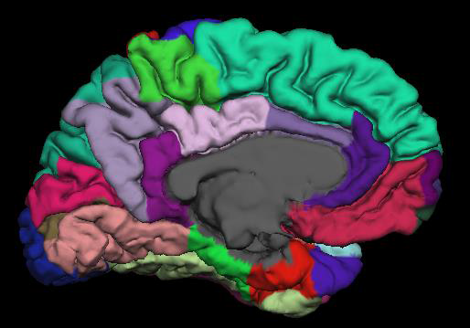
Uncertain; delineation ventricles vs parahippocampal (light green) and entorhinal cortex (red)
Questionable examples:
A
B
Part of the grey matter of the gyri seem not to be allocated to PHG or ERC (but probably to ventricles instead)
However, example A detected in ~70-80% of cases (?), so only exclude when a large part of the gyrus is clearly missing (entorhinal cortex in example B)

Slide 9
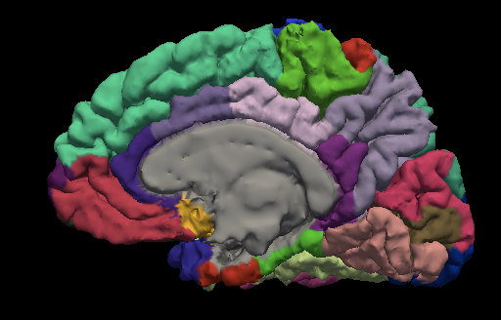
Other issue; Subgenual ACC coded as insula (yellow)
A
B
The atlas used by Freesurfer does not include a subgenual ACC region but allocates this to the insula (yellow) or medial OFC (pink) region instead. Example B is probably more anatomically correct, but judging whether that specific grey matter patch should be insula or medial OFC becomes very arbitrary, so don’t exclude but make a note in how many cases you observe example A.

Slide 10
Outlier log file
Subjects with many regions as surface area outliers: most TOO HIGH -> systematic error (see next slide example from Philipp Saemann’s MPIP dataset)?
Caused by low resolution of the scan or motion?
Solution: if grey matter is not correctly delineated from white matter/pial surface:
1) Apply fix, see:http
http://surfer.nmr.mgh.harvard.edu/fswiki/FsTutorial/ControlPoints_freeview
http://surfer.nmr.mgh.harvard.edu/fswiki/FsTutorial/SkullStripFix_freeview
2) Exclude region

Slide 11
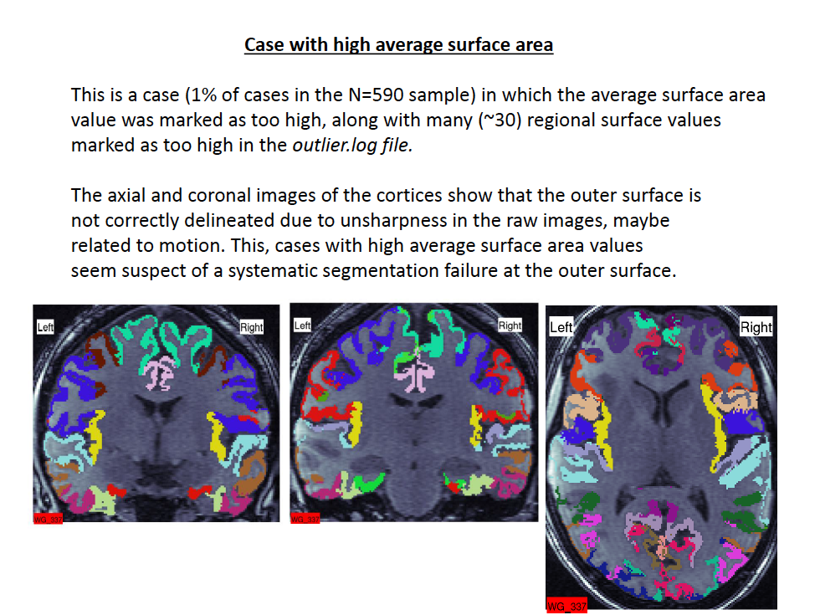

Slide 12
Summary
Most issues related to parcellation of temporal lobes (including banks of STS)
Some studies perform pial/WM mask editing and in worst case scenarios control points on the temporal poles
Other issues/uncertainties consistently reported across sites:
Entorhinal cortex (grey matter patches missing)
Other uncertainties reported:
allocation supramarginal gyrus/superior temporal gyrus/inferior parietal not always correct (exclude regions)
Insula allocation at location of subgenual ACC/medial OFC (excluding region very arbitrary, do not exclude, make note of # cases)

Slide 13
Solutions
Exclude badly parcellated regions (see previous examples) or apply fixes (see http://surfer.nmr.mgh.harvard.edu/fswiki/FsTutorial/TroubleshootingData)
Multisite quantitative analysis of quality of all the parcellated regions (test-retest reliability across FS versions (and across MR field strengths?))
Compare findings from samples who eliminated a lot vs. samples who eliminated few data points (but differences could be a result of differences in study characteristics)
Run 2 separate analyses and compare results:
Including all subjects but excluding NA (i.e. excluded) regions
Including only subjects without NA regions (as usual)
-> these 2 separate analyses are currently in the R script

